Slide 1
PHP in depth 2
3870

Slide 2
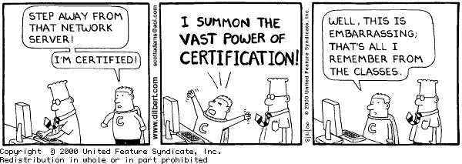

Slide 3
20% project is Omakase
Notes:
http://en.wikipedia.org/wiki/Omakase
http://www.youtube.com/watch?v=b1fZ6hS3hOM

Slide 4
PHP one liner
php –r ' echo "Try and stop us"; '
// Have you included php in your $PATH ?

Slide 5
Regex
PHP support Perl style regular expressions (as we saw in JavaScript)
For a quick review let's go to
http://regexone.com/
Let's solve them up to lesson 15

Slide 6
preg_match
// Perl style regular expression matcher
// You will need to use preg_match_all() to
// match more than one
if (preg_match("/php/i","PHP is a beast")) {
echo "Match Found";
} else {
echo "No match found";
}

Slide 7
preg_match 2
// Pass in a variable to get the matches
preg_match("/php/i","PHP is a beast, go php", $matches);
print_r($matches);

Slide 8
Exercise
Match the domain name in a URL.
e.g. From, http://www.yahoo.com/index.php
get www.yahoo.com
Use http://www.regexr.com to experiment with your regex.

Slide 9
preg_replace
$str = "April 1, 2014";
$pattern = '/(\w+) (\d+), (\d+)/i';
$str_replace = '$3-$1-$2';
echo preg_replace($pattern, $str_replace, $str);

Slide 10
preg_replace 2
<?php
$patterns = array ('/(19|20)(\d{2})-(\d{1,2})-(\d{1,2})/', '/^\s*{(\w+)}\s*=/');
$replace = array ('\3/\4/\1\2', '$\1 =');
// $startDate = 5/27/1999
echo preg_replace($patterns, $replace, '{startDate} = 1999-5-27');
?>

Slide 11
Composer
Using include, require can get complex
Composer solves this problem
First, let's setup composer
https://getcomposer.org/
Then let's take a look at an example
https://github.com/ggc-itec/composer-example
Notes:
To see how Composer actually includes your files read this: https://jtreminio.com/2012/10/composer-namespaces-in-5-minutes/

Slide 12
Exercise
Create your own class in your Composer project and start using it
Try calling a few methods in Carbon ( https://github.com/briannesbitt/Carbon ) in your Composer project
Visit Packagist https://packagist.org/ for all available packages

Slide 13
to be continued

